Slide 1
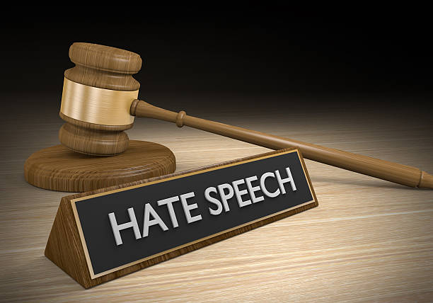
Hate Speech Detection Using NLP
Group 3
Group Members
Bidash Gurung
Pema Chozom
Dorji Thogmey

Slide 2
Overview
Introduction and Problem Statement.
Aims and Objectives.
Demonstration

Slide 3
Problem
Statement

Slide 4
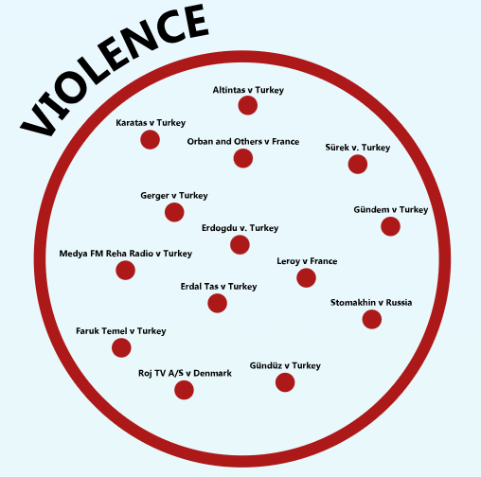


Advances in social media leads to more forms of hate speech.
Creates division and incites violence.
Need for Enhanced Detection Methods

Slide 5
AIMS

Slide 6
Develop a Hate Speech Detection System for commonly used hate speech.
Improve Contextual Understanding of Hate Speech in the model.
Categorize hate speech into different categories

Slide 7
OBJECTIVES

Slide 8
Develop a robust dataset for hate speech detection
Design and implement a context-aware NLP model
Evaluate model performance on real-world social media data
Design and implement an NLP model for classifying hate speech detected

Slide 9
Demonstration

Slide 10
THANK YOU

